Slide 1
Communication
Information by signs and signals speaking, writing or using some other medium and means is called communication.

Slide 2
Effective Communication
…is a communication between two or more people where the intended message is successfully delivered, received, and understood

Slide 3
Learning Objectives of Effective communication
- Sending, receiving and understanding the message or information.
- Development of Interpersonal Skills
- To express effectively & with maximum efficiency

Slide 4
Activity 1
Notes:
(Paper folding activity) – To understand the importance of all components of communication
Step 1- Teacher distributes half a sheet of paper to all students
Step 2- Teacher instructs them not to ask any questions or look at others what they are doing. Teacher gives few instructions, like fold the paper (without telling which way),tear a corner( without telling which corner upper right/upper left/bottom right/bottom left) make a small hole( without telling where and how big)
Step 3- After many incomplete instructions, teacher asks students to open the given papers
Step 4- Students shall be surprised to see that all papers look different.
Conclusion- Students understand the importance of clear, precise and complete instructions for effective communication. They understand the importance of two way communication, which allows the receiver to ask questions from sender for better clarity.

Slide 5
Communication
This is single-handedly the most important quality for your professional and personal life. You need to be able to converse with people from different cultures in person, writing and over the phone. The ability to listen to others and display empathy when necessary is also a fundamental part of communicating effectively.

Slide 6
1. It improves team building
2. It boosts growth
3. It increases innovation
4. It improves productivity
5. It increases efficiency
6. It increases loyalty
7. It reduces mitigation conflict
8. It increases employee engagement
9. It resolves problems
10. It enhances skills

Slide 7
Features of Effective Communication
Common Language
Clear (Right Meaning)
Listening
An input and an output
Notes:
(Paper folding activity) – To understand the importance of all components of communication
Step 1- Teacher distributes half a sheet of paper to all students
Step 2- Teacher instructs them not to ask any questions or look at others what they are doing. Teacher gives few instructions, like fold the paper (without telling which way),tear a corner( without telling which corner upper right/upper left/bottom right/bottom left) make a small hole( without telling where and how big)
Step 3- After many incomplete instructions, teacher asks students to open the given papers
Step 4- Students shall be surprised to see that all papers look different.
Conclusion- Students understand the importance of clear, precise and complete instructions for effective communication. They understand the importance of two way communication, which allows the receiver to ask questions from sender for better clarity.

Slide 8
IMPACT OF EFFECTIVE COMMUNICATION IN OUR LIVES

Slide 9
ELEMENTS OF COMMUNICATION
Sender (Message)
Encoding
Channel/Medium
Decoding
Receiver (Response)
Feedback

Slide 10
BARRIERS TO EFFECTIVE COMMUNICATION
Environmental
Situational
Individual
Attitudinal
Linguistic Ability
Inattention
Emotional State

Slide 11
Communication Styles
Types of Communication
Based on Communication Channels
Based on style and purpose
Non-Verbal
Verbal
Formal
Informal
Oral
Face-Face
Written
Distance
Notes:
There are four main categories or communication styles including verbal, non-verbal, written and visual.
Nonverbal communication is the use of body language, gestures and facial expressions to convey information to others. It can be used both intentionally and unintentionally. Non-verbal communication is helpful when trying to understand others’ thoughts and feelings.

Slide 12
Advantages of Written communication
Permanent Record
Meticulous Presentation
Easy Circulation

Slide 13
Advantages of Written communication
Suitable for Statistical Data
Promotes Goodwill

Slide 14
Disadvantages of Written communication
Time Consuming
Non-Flexible
Less scope for clarification

Slide 15
Disadvantages of Written communication
Demands writing Proficiency
Probability of Wrong Interpretation
Less scope for clarification

Slide 16
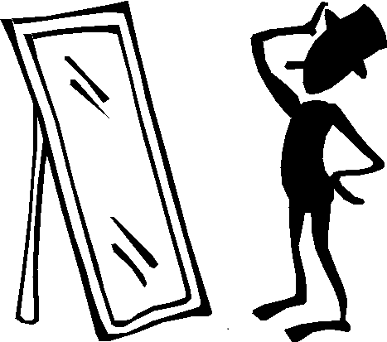


Introduction to Verbal and Non verbal communication
Body Language
Sounds
Appearance
Notes:
Verbal and non-verbal communication go hand in hand in day to day interactions. Let us understand this through an activity.

Slide 17
Activity #2
Notes:
Activity- Narrate a joke/funny incident
Step 1- Facilitator calls upon one student and asks him/her to tell a joke facing the black Board, without using non-verbal mode.
Step 2-The same joke is narrated by the student, this time facing the class and with use of non-verbal modes like body language, gestures etc.
Conclusion- Students observe the reaction of class in both scenarios and understand how non-verbal and verbal communication when used together makes the communication more effective.

Slide 18
Elements of non verbal communication
Appearance
Body Language
Sounds

Slide 19
Appearance
Our choice of color, clothing, hairstyles and other factors affecting appearances are also considered means of non verbal communication
Appearances can also alter physiological reactions, judgments and interpretations
These first impressions are important, which is why experts advise that job seekers dress appropriately for interviews with potential employers.

Slide 20

Body Language
…is an aspect of non-verbal communication where physical behaviour is used (as opposed to or in addition to words) to convey information. It’s important that our body language synergizes with our words

Slide 21
Body Language includes
• Facial expressions
• Posture
• Gestures
• touch
• The use of space
• Eye movement
It’s also known as “kinesics”.

Slide 22
Dos and Don’ts of non-verbal messages and body language

Slide 23
Do’s
• Make eye contact ...
• Have a firm handshake ...
• Check your facial expression ...
• Be natural with your gestures …

Slide 24
Do’s …contd
• Maintain a receptive posture ...
• Refrain from sending mismatched messages ...
• Don't appear disengaged …

Slide 25
Dont’s
• Rubbing your hands together during an important meet up
• Leaning back while meeting with a friend or close colleague.
• Crossing your arms during an interesting conversation.

Slide 26
Dont’s
• Not making eye contact.
• Making too much eye contact.
• Fidgeting.
• Touching your face too often

Slide 27
Some Common Hand Gestures

Slide 29
Advantages of Verbal Communication
Saves Time
Saves Money
Feedback Quickness

Slide 30
Advantages of Verbal Communication
Most Convenient
Ease of Preparation

Slide 31
Disadvantages of Verbal Communication
Chances of Distortion of Meaning
Not Convenient for long messages
Irrelevant Information
Chances of creating misunderstanding

Slide 32
Advantages of Non-Verbal Communication
Complimentary
Easy Presentation
Substitution
Reduces wastage of time

Slide 33
Disadvantages of Non-Verbal Communication
Long explanations are a challenge
Continuous
Multi-chaneled
Culture Bound

Slide 34
Video #
Video #
Notes:
Activities 1) Bulls-Eye ! How good are the students at spotting details? Students will watch a short video clip of any great character and identify all the body language gestures that help define the character’s personality. How does he/she demonstrate comfort and/or discomfort? Does he/she have open/closed body language? Consider watching the video clip first without sound and the students will identify what they think is being communicated through the dialogue. Afterwards, watch the video clip with sound and analyse predictions. Were the gestures and words congruent?
https://www.youtube.com/watch?v=9mENdFKtGI0
https://www.youtube.com/watch?v=Ks-_Mh1QhMc

Slide 35
Activity
Notes:
Activity 2 – Who am I? Teacher tells students to depict their favourite cartoon Character/celebrity/Freedom fighter in nonverbal cues. Other students have to guess the character.

Slide 36
Activity # 5
Notes:
Activity 3- Act out this scene with your partner using as many appropriate gestures and body language as possible
A: Hey you!
B: Me?
A: Yes. Come here
B: Can I help you with something?
A: Don’t you know me?
B: Hmm Oh! We met last week at railway station .right? Your name…..
A: That’s right. I am…………… How are you? B: Not good, sorry. I just lost my wallet.
A: Oh No! Do you remember where did you leave it?
B: That is the problem. I don’t remember and all my money was in that.
A: Listen, I am running late. But I can help you.
B: That is so nice of you. If you could lend me a little sum of money to reach my home. I shall return it tomorrow.

Slide 37
sounds
Sounds
Sounds here refer to vocal communication that is separate from actual language. This includes factors such as tone of voice, loudness, and pitch
Consider the powerful effect that tone of voice have of meaning of sentence. When said in a strong tone of voice, listeners may interpret approval and enthusiasm. The same words said in a hesitant tone of voice might convey disapproval and a lack of interest

Slide 38
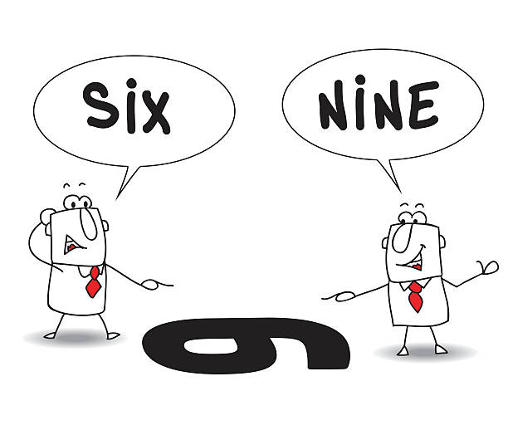
Perspectives in Communication
Perspective focuses on the way in which our shared meanings and practices are constituted through language and symbol, the construction of messages, and their dissemination through media, organizations, and society

Slide 39
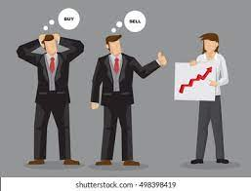
… We all come to each communication exchange with our own ‘filter’ through which we see the world, the person we are communicating with, and the situation or topic we are communicating about.

Slide 40
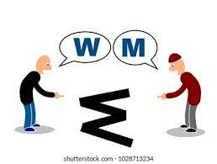
These filters mean that we don’t always start with the same perspective as the person we are communicating with shall differ each time

Slide 41
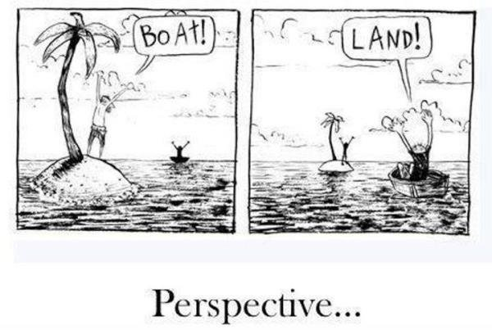

Slide 42
Factors Affecting Perspectives in Communication
- Visual Perspective

Slide 43
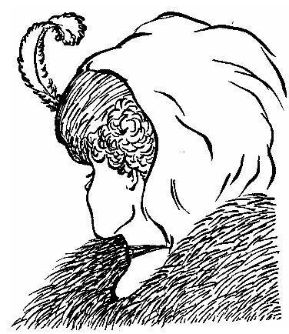

Slide 44
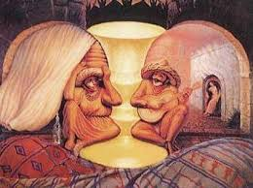

Slide 45


Slide 46
- Past Experiences
- Attitude
- Prejudices
- Feelings
- Environment
- Beliefs

Slide 47
- Attitude

Slide 48


Slide 49
- Prejudice
- Feelings
- Environment
- Beliefs

Slide 50
Dr. Berne’s theory on Transactional Analysis
aptly describes the effect of our belief system on our behaviour.
This theory outlines how we treat ourselves, how we relate and communicate with others.

Slide 51
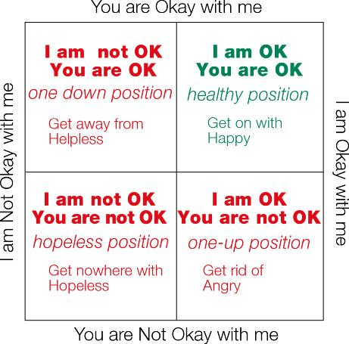

Slide 52
Factors Affecting Communication at Workplace
- Cultural Diversity
- Misunderstanding of Message
- Emotional Differences
- Past Experiences

Slide 53
Factors Affecting Communication at Workplace
- Educational and Intellectual Differences
- Positional Differences
- Functional Differences between Sender and receiver

